Slide 1

Wireless Networking
Ambuj Varshney
ambujv@nus.edu.sg

Slide 2
Discussion regarding Assignment 3
Assignment 3: April 8th April
Submission after deadline: Penalty of 10% Per Day (Last date: 15th April)
Additional sensor tags are available if required
Please email: Dhairya Shah (details on course page)
Please submit statement of work and report. The statement of work should describe the contribution made by every member of the group. Only one member should submit the assignment on the canvas.

Slide 3
Roadmap of the lecture today
General course information and updates
Let us review what we had covered the last lecture
Localization continued
Node discovery
Wide area networks
Routing
Notes:
Here is the roadmap of the major topics that I am going to cover during the presentation. We have already covered the exponential growth of the internet of things; next, I will talk about the critical energy challenge that can severely hinder this massive growth and preventing us from realising this immense economic value enabled by the IoT.

Slide 4
Medium access control for Internet of Things
Medium access control for normal wireless devices
Low Latency
High Utilization
Fair (every has chance to communicate)
How about medium access control for internet of things?
Power Consumption should be as small as possible
(Most) sensor applications have low channel utilization
Designing medium access control with energy consideration as priority?

Slide 5
Energy consumption of medium access control
The main sources of energy consumption in any contention-based MAC protocol:
overhearing
control packet overhead
data transmission/reception
idle listening
(1) – (3) occurs only when there is a transmission
(4) occurs even when there is no traffic

Slide 6
“Life Cycle” of MAC Protocols
(4)
(1) – (3)
(4)
(1) – (3)
(4)
(1) – (3)
Less Traffic
(4)
(1 – (3)
(4)
(1) – (3)
Less Traffic
(4)
(4)

Slide 7
Aloha with Preamble Sampling
Sensing
Sensing
Sensing
Sensing
Receiver
Sender
Preamble
Data
Sensing
Sensing
Sensing
Recv
ACK
Receiver 1
Sensing
Sensing
Receiver 2
(Possible we can miss the preamble and thus data?)

Slide 8
Aloha with Preamble Sampling
Tp
Sender
Preamble
Data
Sensing
Sensing
Sensing
Recv
ACK
Receiver 1
Ts
T_{D}
Each receiver periodically (every Tp) wakes up to check if the channel is busy for a duration of (Ts)
If channel is busy, stays in listening mode until destination of data is known (transmitted), else go back to sleep for a period of (Tp-Ts)
Sender transmits a long preamble (Tp), and then send data packet at the end of the preamble period of packet transmission
Is this protocol energy efficient? Why? And Why Not?

Slide 9
B-MAC: Asynchronous Medium Access Control
B-MAC asynchronous MAC protocol. Based on concept of preamble sampling
Nodes periodically activate their radios to detect signals; remain active upon receiving a packet or go to sleep after a set timeout if no activity is detected
To guarantee packet reception, the preamble duration must be at least as long as the channel sampling rate
The preamble time (Tp) should align with the channel check interval for reception; for instance, a 100ms check requires a minimum 100ms preamble

Slide 10
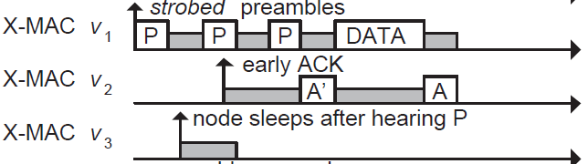
Improving B-MAC with X-MAC
X-MAC improves over B-MAC
Sender transmits many “probes” with gaps between probes. Each probe contains address of intended receiver
Receiver checks address embedded in probe, sends acks if it is the destination during the gap period between probes
Sender transmits DATA, receive replies with Ack to complete data transfer

Slide 11
ContikiMAC
ContikiMAC is the MAC protocol implemented in Contiki OS

Slide 12
Roadmap of the lecture today
General course information and updates
Let us review what we had covered the last lecture
Localization continued
Node discovery
Wide area networks
Routing
Notes:
Here is the roadmap of the major topics that I am going to cover during the presentation. We have already covered the exponential growth of the internet of things; next, I will talk about the critical energy challenge that can severely hinder this massive growth and preventing us from realising this immense economic value enabled by the IoT.

Slide 13
What do you mean by the term localization?
Localization systems determine the physical coordinates of an electronic device such as IoT nodes, drones, mobile phones or a subject
These physical coordinates of electronic devices are:
Global - aligned with some externally meaningful systems like GPS
Relative - some “rigid transformation” (rotation, reflection, translation) away from a global coordinate systems
Localization indoors: goal is positioning things within a building
Where can I find X?
X: where am I located?
X and Y: are we near each other?

Slide 14
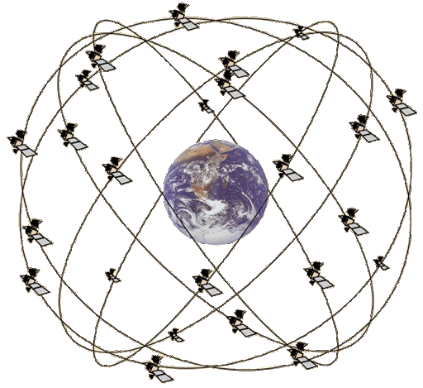
Overview of Global Positioning System
Satellites placed in Medium Earth Orbit (20,000 KM)
Orbit earth twice per day
Placed such that 4 are in view everywhere, always
31 total in orbit as of November 2020
Most recent launch November 5th 2020
Comparisons
LEO 200-2000 km, ISS at 340 km
GEO 35,000 km

Slide 15
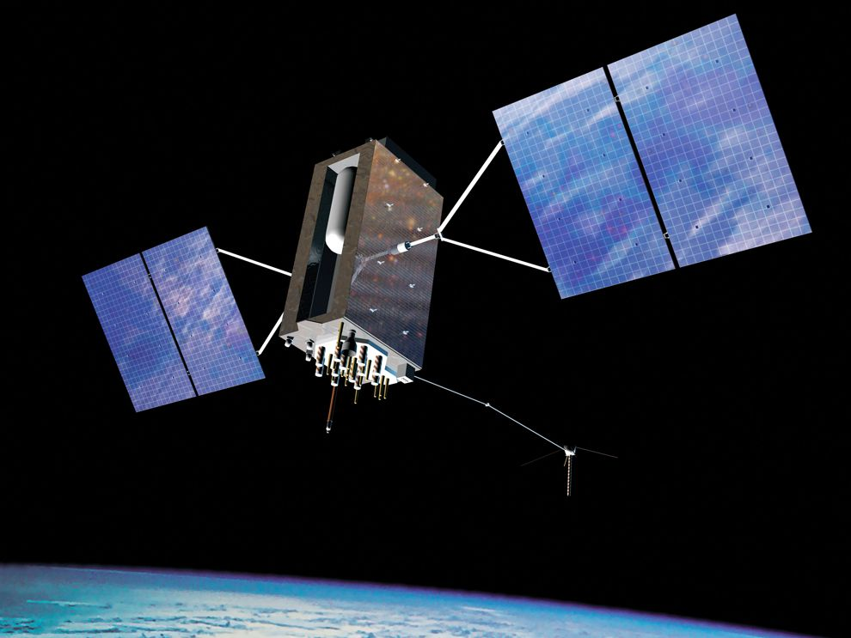
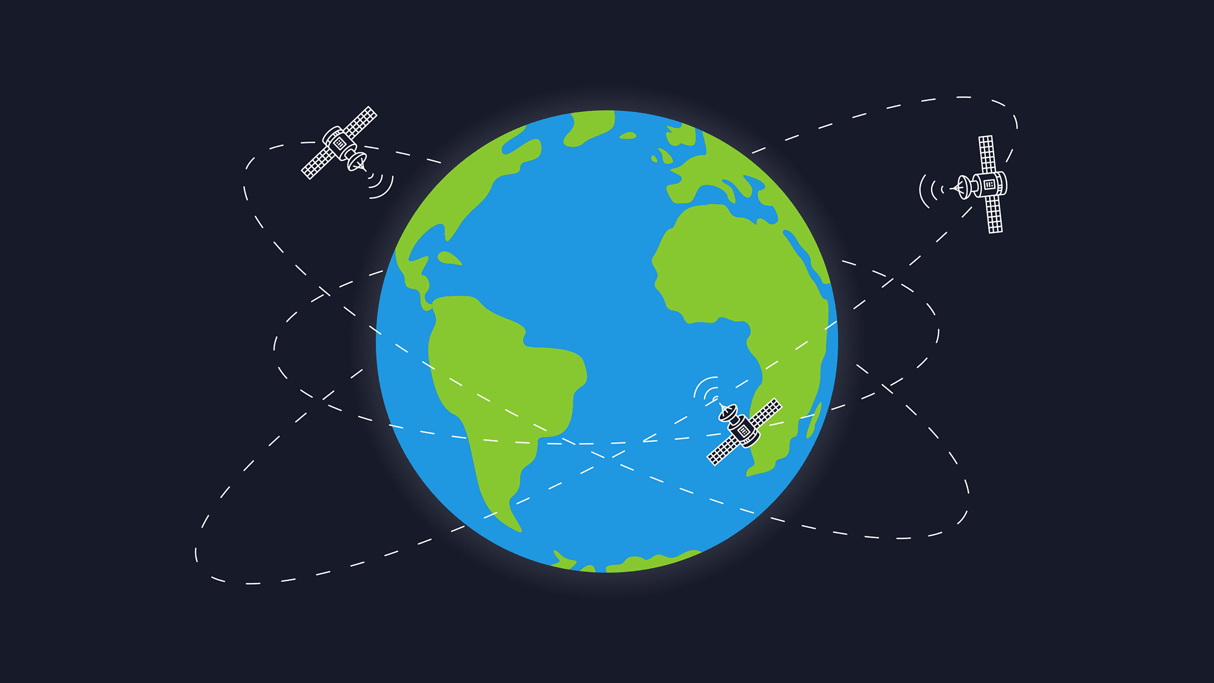
Global Positioning Service
How does GPS work?
Know the position of all satellites
Receive signals from multiple satellites
Determine distance from each satellite
Trilateration

Slide 16
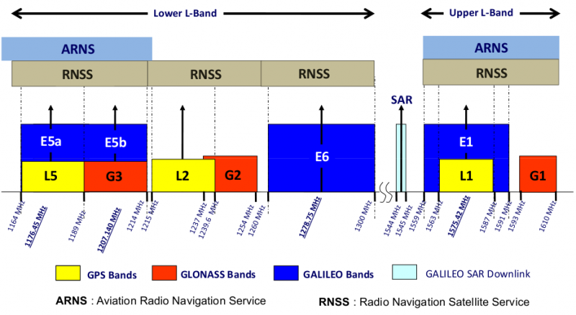
GPS PHY
GPS frequency
1.2 GHz and 1.5 GHz
10-15 MHz bandwidth
BPSK modulation
Signal has to travel 20,000 km, but most of that is through space
Tx power 25 Watts (44 dBm)
Rx sensitivity -140 dBm to -160 dBm (50 bps data rate)
~200 dBm total link budget

Slide 17
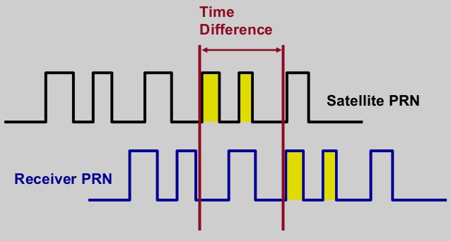
GPS transmissions
Each satellite sends a unique pseudo-random number sequence
Sequence repeats in time (over minutes) and is well-known
Position in signal is used to calculate time of flight

Slide 18
GPS requires signals from multiple satellites
4 satellites are needed to determine location and time
3 for 2D location (assume on ground) and 1 for time offset
Solve for both as a single equation
Steps to finding location
Initialize time to whatever you heard from a satellite (~100 ms sync)
Get time of arrival from four satellites
Four variables
x, y, z, and time offset

Slide 19
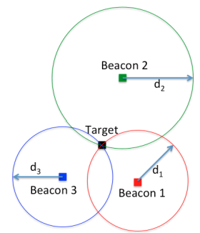
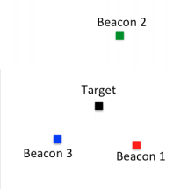
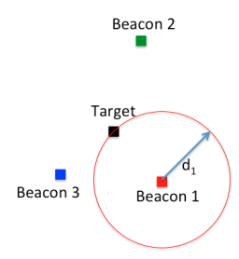
What is trilateration?
Determine distance from each beacon, then find position
Apply trigonometry to solve triangle with beacons.
Requires: 3 lengths (or some angles and lengths…)
Solve two triangles and get 3D position
Most common and accurate localization approach

Slide 20
How to determine distances?
Making trilateration work requires distance measurements
There are numerous techniques for distance measurement
RSSI (Received Signal Strength Indicator)
Time of Flight/ Time of Arrival
Time Distance of Arrival

Slide 21
Received Signal Strength Indicators (RSSI)
RSSI - received signal-strength indication
In theory, RSSI varies with 1/d^{α}
One common assumption, nodes that are closer have stronger RSSI than those further
In practice, RSSI ranging measurements contain noise on the order of several meters, highly non-uniform
Radio propagation differs over different surface (water, grass, asphalt etc.)
Obstacles such as wall, furniture etc.

Slide 22
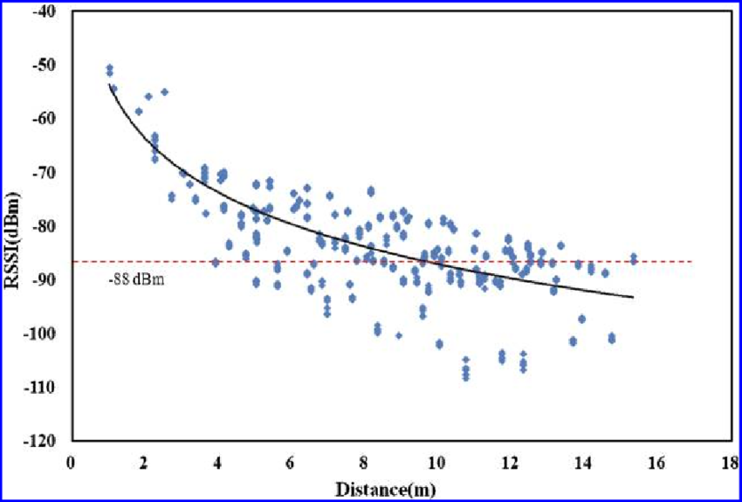
Problem with RSSI-based distance – not accurate
Pathloss is NOT only due to distance
RSSI is way worse at this than you hope it would be
Citation: literally everyone has made this figure at some point

Slide 23
Time of flight (also known as time of arrival, ToA)
Determine distance by knowing:
Exact position of infrastructure
Transmit time
Receive time
Signal velocity (i.e. speed of light)
Infrastructure transmits and device listens
Can happen all the time, but devices only listen when they want a position
Requires time synchronization between infrastructure and device
Synchronization must be good: 1 μs = 300 meters

Slide 24
Time of flight (also known as time of arrival, ToA)
Important Considerations:
Speed of signal propagation
Distance to be measured
Clock accuracy
Example:
Speed of light (c) ~ 3x10⁸ m/s
Distance travel in 1ms = 300m
Clock accuracy needed for meter accuracy (1/c) ~ 3ns
Speed of sound (v) ~ 330 m/s
Distance travel in 1ms = 0.33m
Clock accuracy needed for meter accuracy = 1/v ~ 3ms

Slide 25
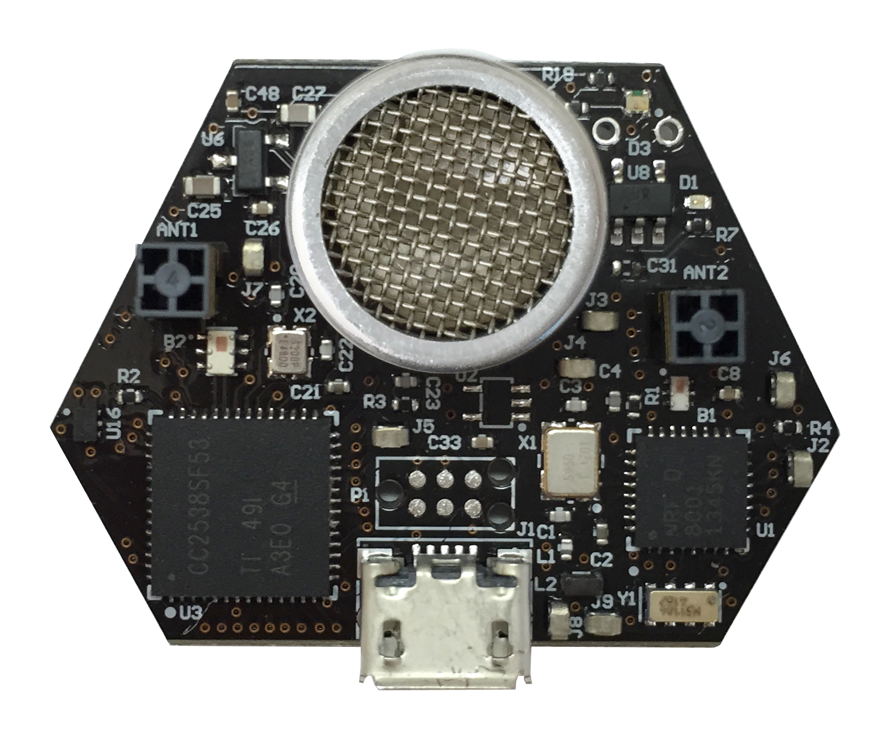
Ultrasound
Advantages
Solves the barrier problem
Human spaces already designed to contain sound
Easier to get high-accuracy results
Sound is ~1,000,000x slower than light
Less synchronization is needed to get same accuracy
Disadvantages
More energy to transmit
Slower update rate (still sub-second)
Limited range
Pets can hear it…

Slide 26
Time difference of arrival (TDoA)
Device transmits and infrastructure receives transmission
Multiple infrastructure nodes receive at different times based on distance
Determine distance by knowing
Exact position of infrastructure
Time of arrival at two different locations
Signal velocity (i.e. speed of light)
Doesn’t require synchronization with infrastructure!
Still requires synchronization between infrastructure nodes
Does require device to transmit loud enough for infrastructure to hear it…

Slide 27
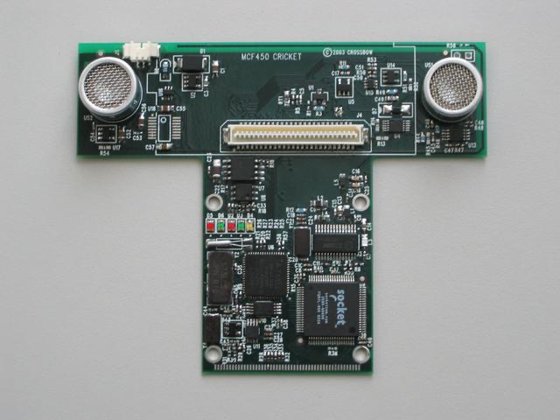
Time difference of arrival with different mediums
Exploit differences in speed, say RF and audio
Example: Cricket System [1]
In addition to a radio, each node also has a speaker and microphone
How does Cricket works?
Transmitter sends a radio message, waits some time (optionally) t_delay, sends audio “chirp” sound
Listener hears the radio signal, record time t_radio
Listener hears the audio signal, record time t_sound
[1] http://cricket.csail.mit.edu/

Slide 28
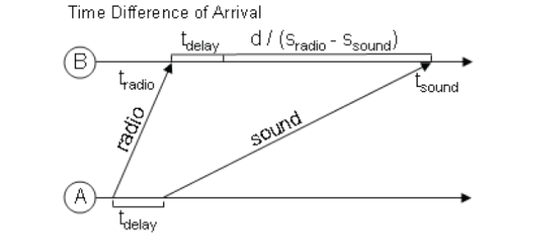
Time difference of arrival with different mediums
Time diff between signal arrival = d/S_{Sound} – d/S_{Radio} + t_{delay}
Works well in LOS environment
Cricket (uses ultra sound) can obtain close to cm accuracy
Requires additional hardware and works better with calibration

Slide 29
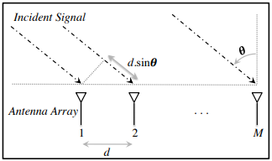
Angle of arrival (AoA)
Trilateration doesn’t only require distances, angles work
Antenna arrays can be used to determine the angle of an incoming signal
Allows the use of normal RF communication (WiFi or BLE)
BLE 5.1 includes AoA localization

Slide 30
Mapping existing infrastructure
Can we repurpose existing infrastructure for localization?
For example: WiFi access points
Benefit: localization works with unmodified hardware
Mapping instead of trilateration
Make a map of infrastructure and use that to locate device
Coarse example: existence of WiFi network SSIDs
Fine-grained example: signal strength to each Access Point
Known as fingerprinting

Slide 31
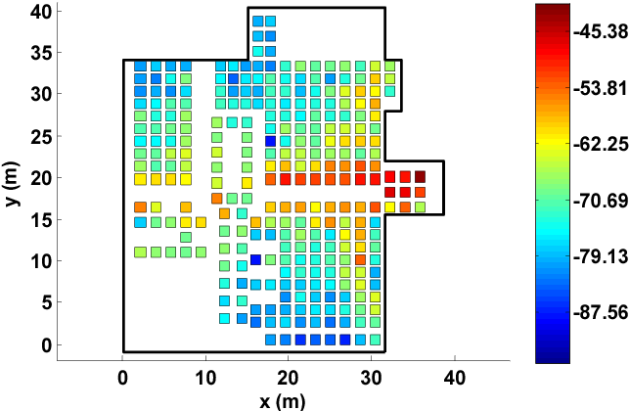
Fingerprinting overview
At setup time, for many locations throughout building
Measure signal strength to Access Point
Record measurement in a database with location
At run time, for the device that wants a location
Measure signal strength to Access Point
Look up measurement in database to get location

Slide 32
Fingerprinting improvements
Measurements can use several Access Points simultaneously
Improves accuracy quite a bit
Doesn’t have to be WiFi based at all
Cellular networks can do fingerprinting
Deploy your own BLE beacons throughout environment
Apply techniques for minimizing error in signal strength
Measurement won’t match record exactly
But minimizing error should approach the same location

Slide 33
Fingerprinting challenges
Effort to create database in the first place
Manually take measurements at every location
Environment is not stable
Signal strength changes as chairs, doors, and people move
Need ability to periodically re-measure
Update database with most recent recording while in use
Measurements vary between devices
Differ based on antennas, cases, how you hold it, etc.

Slide 34
Fingerprinting accuracy
State-of-the-art: median accuracy of 0.5-1.5 meters
Not bad depending on the application!
Likely places you in the right room, or at least nearby
Long tail can be large, but more access points helps this
Barrier problem capability depends on walls
Some materials attenuate signal strength more than others

Slide 35
Similarity of WiFi Fingerprints
Hong, Hande, et.al. "Socialprobe: Understanding social interaction through passive wifi monitoring." Mobiquitous 2016.

Slide 36
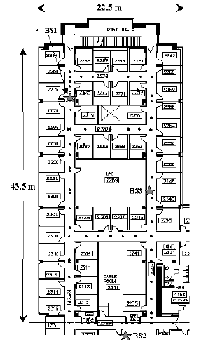
Localization using (WiFi) Fingerprinting
RADAR is one of the earliest & most highly cited localization using WiFi based fingerprinting (>12,000 citations on scholar.google.com)
Testbed:
1 floor, 980 sq. meters, 50 rooms
3 base stations, 1 mobile host

Slide 37
Inertial navigation
If you know acceleration, you can get position, just integrate!
With quite a bit of error
Accurate over short distances with filtering approaches
Can be used to augment other systems
Get a fix every few seconds from localization system
Use inertial navigation to interpolate between measurements
IMUs (Inertial Measurement Units) available in all smartphones
Accelerometer, Gyroscope, Magnetometer

Slide 38
Roadmap of the lecture today
General course information and updates
Let us review what we had covered the last lecture
Localization continued
Node discovery
Wide area networks
Routing
Notes:
Here is the roadmap of the major topics that I am going to cover during the presentation. We have already covered the exponential growth of the internet of things; next, I will talk about the critical energy challenge that can severely hinder this massive growth and preventing us from realising this immense economic value enabled by the IoT.

Slide 39
Node Discovery

Slide 40
How to discover nodes or devices nearby
Scenarios for local discovery
You just enter a shopping mall. You would like to check if there is WiFi service. How does your mobile phone discover the presence of WiFi networks?
Small devices with low power network interface (e.g. ZigBee) are deployed in the surrounding and carried by humans. How can these devices discover other devices in range (in an energy efficient way)?

Slide 41
How to perform neighbor discovery?
Problem is “easy” to solve if there is no constraint and all nodes can be active all the time.
Challenge is to design a protocol that is energy efficient.
Two broad methods for local neighbor discovery:
Synchronous
Asynchronous

Slide 42
Synchronous neighbor discovery
All nodes are synchronized to the same clock/time.
Nodes wakeup periodically at same time to transmit/receive packets
Node A discovers node B when it hears a transmission from node B
Example:
Time divided into slots of 100ms and there is a global starting reference time t₀ sec
With a 10% duty cycle, period is 1s,
each node wakes up at t₀ + k sec for 100ms, where k = 0,1,2,3,4….
With a 1% duty cycle, period is 10s,
each node wakes up every t₀ + 10k sec for 100ms, where k = 0,1,2,3,4….

Slide 43
Drawbacks to synchronous neighbor discovery?
Synchronization can be expensive and periodically re-synchronization will be needed to correct for clock drift over time
As all nodes wakeup at the same time to transmit/receive, collision may increase if too many node transmit simultaneously

Slide 44
Synchronous neighbor discovery with Asymmetric Nodes
Some nodes are more powerful and is always “ON”
Example: WiFi APs (always ON) vs. mobile device (stays in OFF state as much possible)
A mobile device wants to discover nearby APs
APs are always awake
Mobile device broadcasts (how often?) a probe beacon and listens for replies
How about AP periodically broadcasts and mobile replies?
A mobile device is associated with an AP but wants to conserve energy by going into sleep state whenever there is no data communication
How does the device know there is data from the AP if it is in sleep state?

Slide 45
Power Save Mode (Infrastructure)
When a mobile device wants to go into Power Save Mode (PSM), it informs the AP and goes into sleep state (switches off its radio)
Any packets arriving at the AP for the mobile device in PSM are stored in the AP’s buffer
The AP sends a beacon frame after every fixed time interval. The beacon frame has a field called traffic indication map (TIM) to inform the device in PSM about incoming packets.
Device in PSM wakes up periodically to listen to beacon frames and switch to active state if there are incoming packets

Slide 46
Asynchronous Protocols
Challenges:
No time synchronization
All nodes are resource constrained
Assumptions
Divide into time slots (e.g. 100ms)
Each device decides (randomly?) which time slots to wakeup to transmit/listen
How long will two such devices take to discover each other?

Slide 47
Birthday Paradox
In a group of N people, what is the probability that there is at least one pair of people who have the same birthday? (assume 365 days in a year)
In general, Prob = 1 – P(none of the N people have the same birthday)
N = 2, Prob = 1 – (364/365)
N = 3, Prob = 1 – (364/365)(363/365)
N = 4, Prob = 1 – ((364/365)(363/365)(362/365)
N = n, Prob = 1 – 365!/(365^{n}(365-n)!)
Example:
N = 2, Prob = 0.0027
N = 23, Prob = 0.5073
N = 50, Prob = 0.9704

Slide 48
“Birthday” Protocol
Easy to implement
Good average discovery latency but unbounded worst case

Slide 49
Application to Asynchronous Discovery Michael J McGlynn and Steven A Borbash. Birthday protocols for low energy deployment and flexible neighbor discovery in ad hoc wireless networks. In MobiHoc, 2001
Two nodes randomly choose to wakeup k time slots out of a total n slots. What is the probability that they wakeup at the same time slot at least once?
Probability (Q) can be written down as:
(1%) n = 100, k = 1, Q(100,1) = 0.01
(5%) n = 100, k = 5, Q(100,5) = 0.23
(1%) n = 1000, k = 10, Q(1000,10) = 0.096
(5%) n = 1000, k = 50, Q(1000, 50) = 0.928
Drawbacks – probabilistic bound for discovery time, can take very long sometimes
Can we do better in terms of the worst case?

Slide 50
DISCO - Asynchronous neighbor discovery algorithm
Scheduling radio wake times at multiples of prime numbers to ensure deterministic discovery
Nodes can have different duty cycles
Version 0: A node i picks a prime number, say p_{i} and wakes up p_{i} timeslots, the duty cycle is (1/ p_{i}). In the worst case, two nodes p_{i} and p_{j} will meet after (p_{i} * p_{j}) timeslots.
Problem: what if both nodes pick the same prime number?
Version 1: A nodes i picks a prime number, say p_{i1} and p_{i2} (p_{i1} != p_{i2}), wakes up every p_{i1} and p_{i2} timeslots. The duty cycle is (1/p_{i1} + 1/p_{i2})
If both nodes pick the same pair of prime number:
Duty cycle ~ (p_{i1} + p_{i2})/ p_{i1} p_{i2}, Worst Case ~ p_{i1} p_{i2}
Dutta, Prabal, and David Culler. "Practical asynchronous neighbor discovery and rendezvous for mobile sensing applications." Proceedings of the 6th ACM conference on Embedded network sensor systems. 2008.

Slide 51
Roadmap of the lecture today
General course information and updates
Let us review what we had covered the last lecture
Localization continued
Node discovery
Wide Area Networks
Routing
Notes:
Here is the roadmap of the major topics that I am going to cover during the presentation. We have already covered the exponential growth of the internet of things; next, I will talk about the critical energy challenge that can severely hinder this massive growth and preventing us from realising this immense economic value enabled by the IoT.

Slide 52
Wide-Area Networks

Slide 53
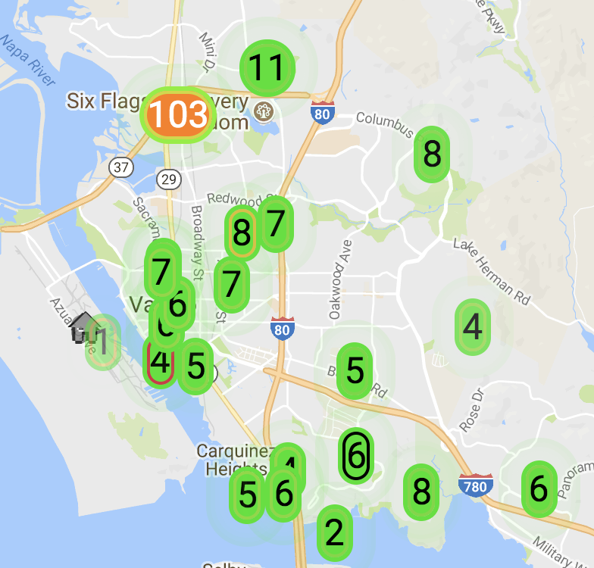
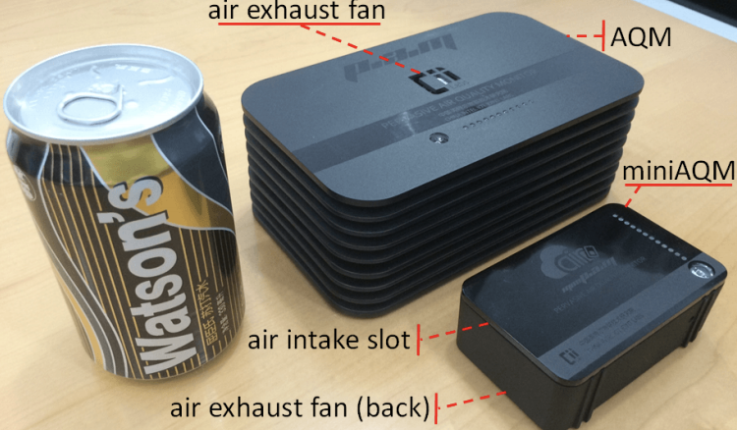

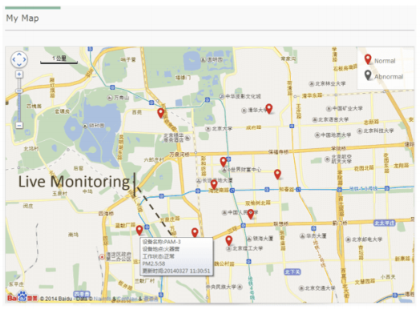
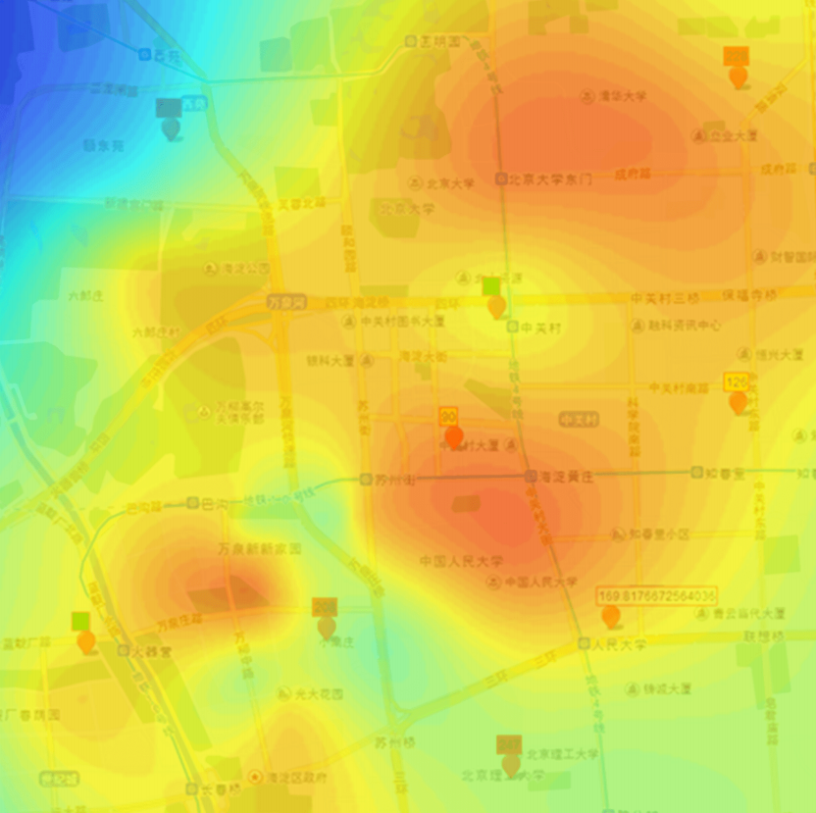
Air quality monitoring
[2]
[2]
[1]
[1]
[1] Cheng et al. AirCloud: a cloud-based air-quality monitoring system for everyone. 2014. [2] Purple Air. 2018.

Slide 54
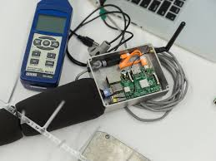
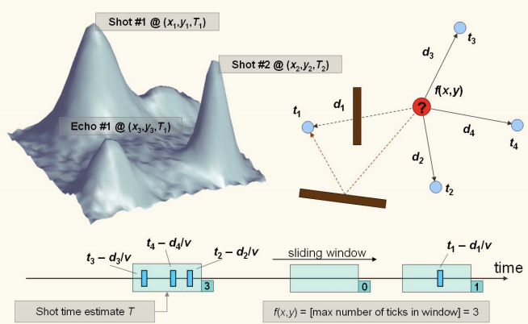
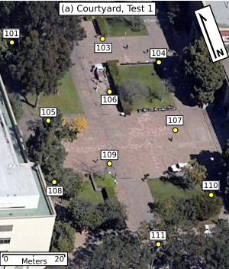
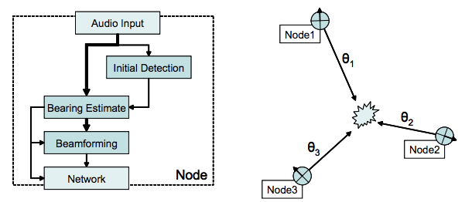
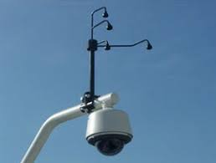
Audio detection, classification, and localization
[3]
[2]
[1]
[1]
[1] Girod et al. The Design and Implementation of a Self-Calibrating Distributed Acoustic Sensing Platform. 2006. [2] Lédeczi et al. Multiple Simultaneous Acoustic Source Localization in Urban Terrain. 2005. [3] Sounds of New York City. 2016.

Slide 55
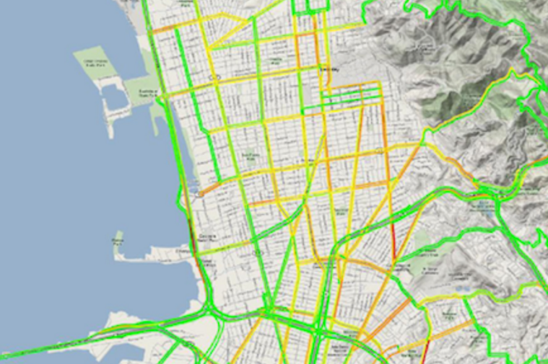
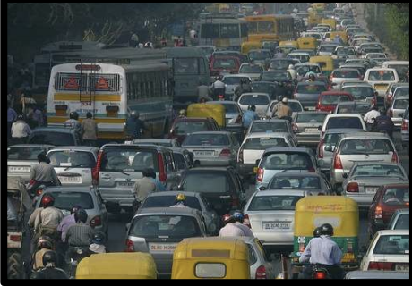
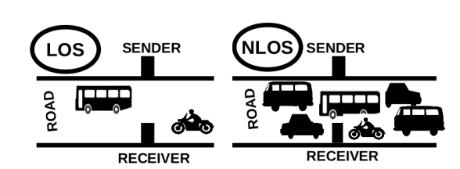
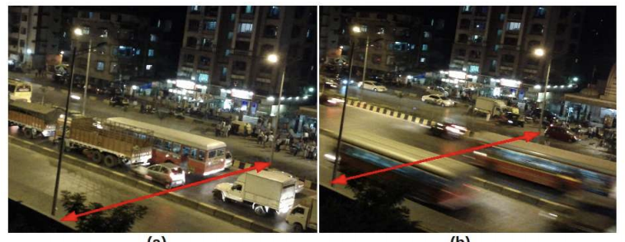
Traffic queue sensing and congestion control
[1]
[1]
[1]
[1] Sen et al. Kyun Queue: A Sensor Network System To Monitor Road Traffic Queues, 2012

Slide 56
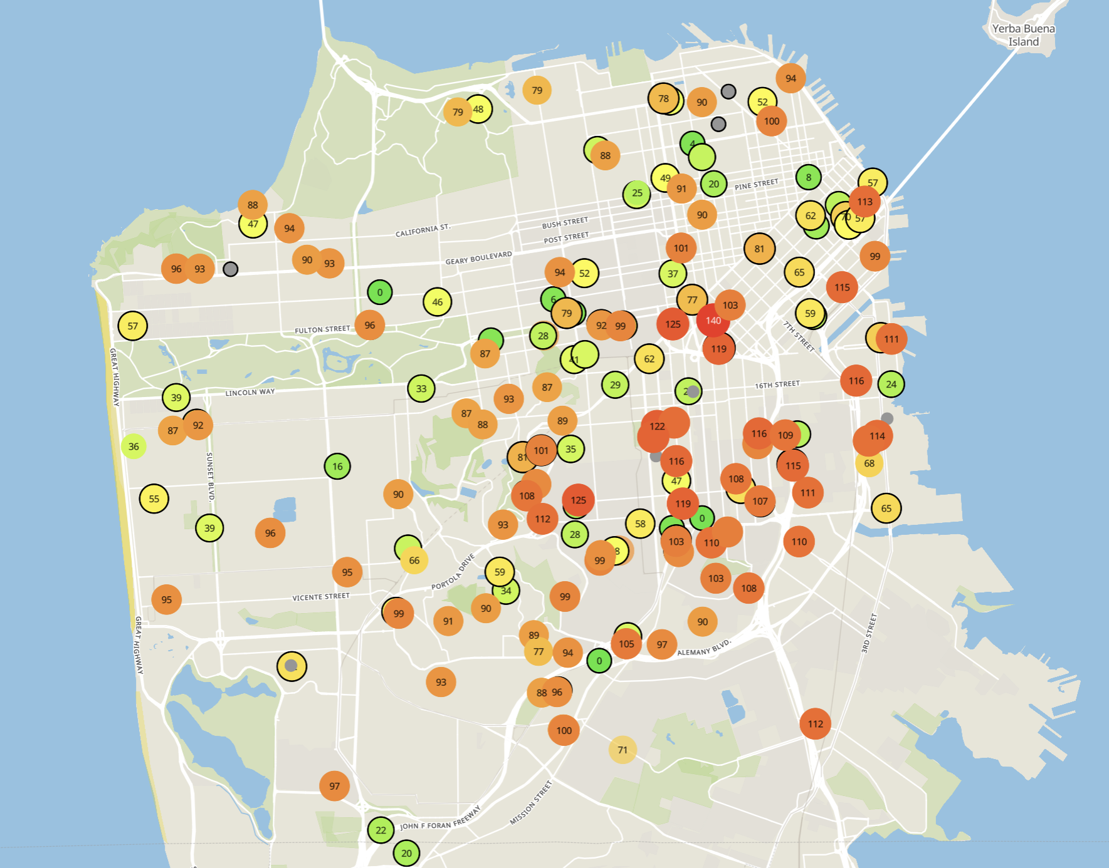
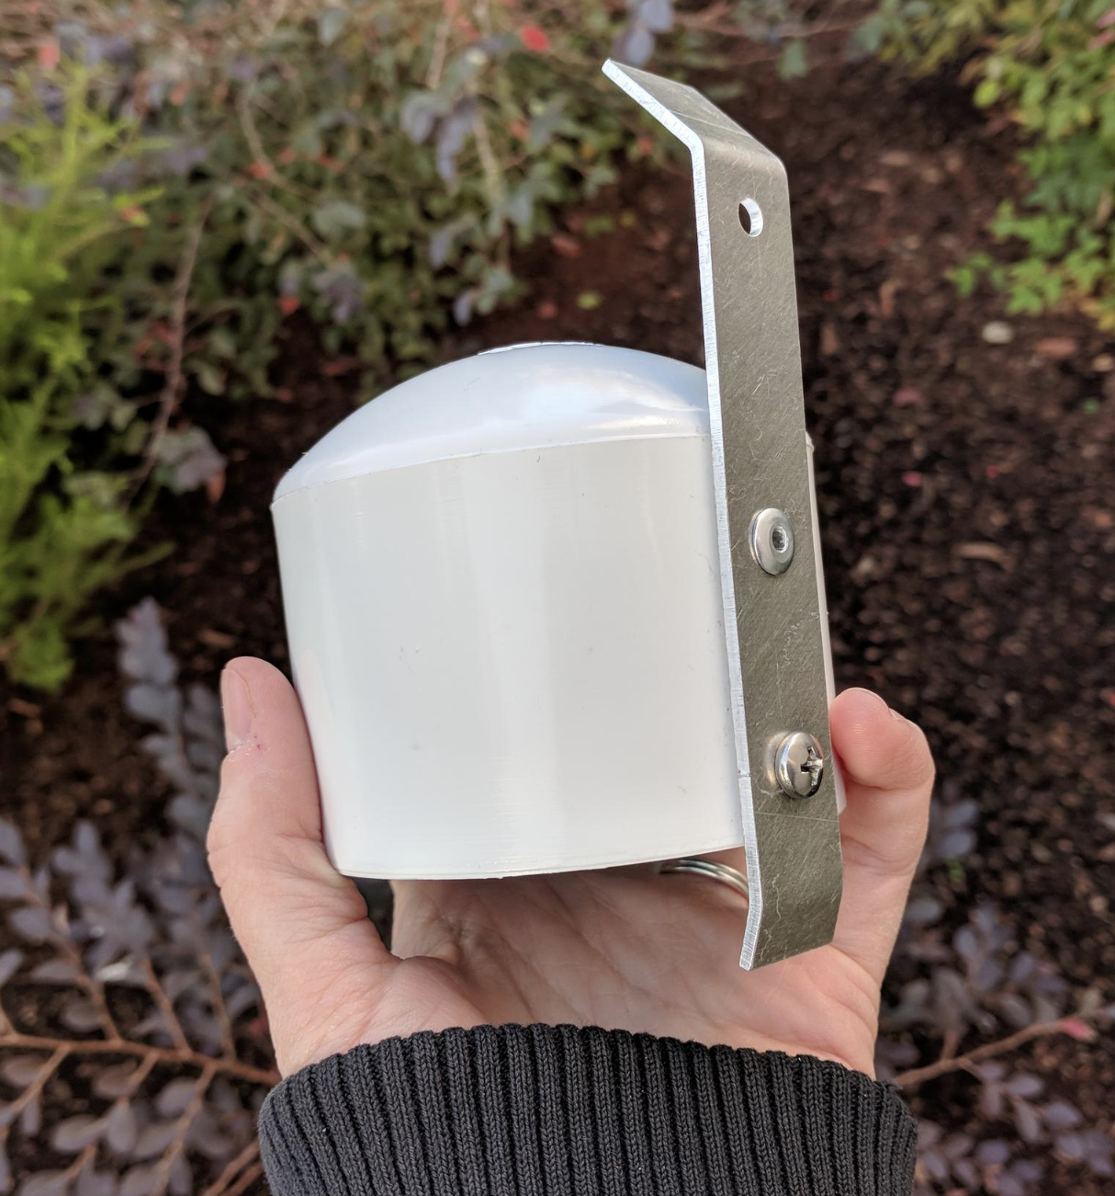
Example application: air quality monitoring
[1]
[2]
[2]
[1] Cheng et al. AirCloud: a cloud-based air-quality monitoring system for everyone. 2014. [2] Purple Air. 2019.

Slide 57
How do we collect data from a sensor?
Manually collect measurements
Connect it to WiFi (or Ethernet)
Pay for cellular access

Slide 58
How do we collect data from MANY sensors?
Manually collect measurements
Too much work
Connect it to WiFi (or Ethernet)
Too many separate networks
Pay for cellular access
Too expensive for many devices

Slide 59
We need another network option
Requirements:
Wide area of coverage
Deploy fewer gateways
Low power
So we can deploy on batteries
Doesn’t need high throughput
Sensor data is relatively small

Slide 60
Long-range,low-data needs are not easily met
WiFi
Data
Throughput
Range

Slide 61
Long-range,low-data needs are not easily met
WiFi
Data
Throughput
Bluetooth
BLE
Zigbee
Range

Slide 62
Long-range,low-data needs are not easily met
WiFi
Higher Power & Higher Cost
Data
Throughput
Bluetooth
BLE
Zigbee
Lower Power & Lower Cost
Range

Slide 63
Long-range,low-data needs are not easily met
WiFi
4G
Higher Power & Higher Cost
3G
Data
Throughput
2G
Bluetooth
2G
BLE
Zigbee
Lower Power & Lower Cost
Range

Slide 64
Long-range,low-data needs are not easily met
WiFi
4G
Higher Power & Higher Cost
3G
Data
Throughput
Bluetooth
2G
Low-Power Wide-Area Networks
BLE
Zigbee
Lower Power & Lower Cost
Range

Slide 65
Long-range, Low-power: design choices
How would you design PHY for long-range, low-power ?

Slide 66
Long-range, Low-power: design choices
How would you design PHY for long-range, low-power ?
Modulation
Tx Power
Carrier Frequency Band
Data Throughput
Channel Bandwidth

Slide 67
Long-range, Low-power: design choices
How would you design PHY for long-range, low-power ?
Modulation
Unclear. Perhaps, not complicated or complex (simple devices)
Tx Power
High (much higher than 0 dBm)
Carrier Frequency Band
Low (something lower than 2.4 GHz, 915 MHz or lower?)
Data Throughput
Low (much lower than 1 Mbps)
Channel Bandwidth
Unclear. Likely smaller for lower frequency carrier.

Slide 68
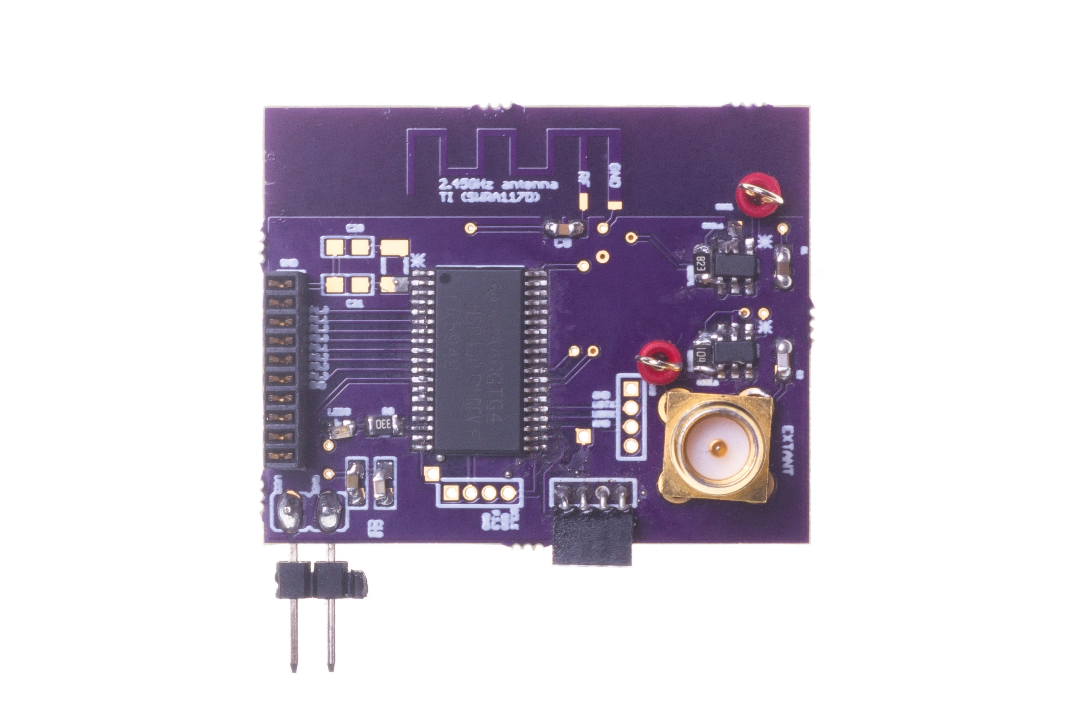
Long range backscatter transmissions using LoRea
LoRea is a long range, low-power, and low-cost backscatter architecture
System Overview
Backscatter Tag Hardware Prototype
(Peak Power of 70 µW)
Varshney et al. ”LoRea: A Backscatter architecture that achieves a long communication range” ACM SENSYS 2017
Notes:
+ Over the past several years, I have designed systems that overcome these critical limitations that have hindered the backscatter systems and have the prevented widespread adoption of the backscatter mechanisms on the Internet of Things devices. One of these systems is LoRea.
+ LoRea was presented at ACM SENSYS, which is a flagship conference in the area of embedded sensor systems. I show the architecture of LoRea on the left-hand figure on the slide. It consists of one or more commodity devices such as a smartphone or Wi-Fi router that provides the necessary carrier signal to support backscatter transmissions, a low-power backscatter tag that I had designed and transmit at a peak power of 70uw, and one or more receiver of backscatter transmissions.
+ The key highlight of LoRea was that it could achieve a significantly larger communication range than existing systems, was designed using off the shelf components and cost (few tens of USDs). Further, the backscatter tag could achieve this capability at orders of magnitude lower energy than commercially available radio transceivers.
+ How did LoRea achieve this capability? We would describe next.

Slide 69
LoRea backscatter narrow bandwidth transmissions which improves sensitivity
Key idea: Receiver sensitivity improves as we lower bandwidth
Lower bitrate (2.9 kbit/s) generates narrow bandwidth transmissions
Low bitrates are not detrimental to most sensing applications
Operating frequency | Bandwidth
868 MHz | 13 kHz
2.4 GHz | 180 kHz
Notes:
+ The third design element that we incorporate in LoRea enables us to significantly improve the communication range. We use key idea that the receiver sensitivity improves as we lower the bandwidth and bitrate. In LoRea, we intentionally generate narrow bandwidth transmissions, in fact, in LoRea we transmit at 2.9 Kbits and generate transmissions of 13 KHz bandwidth. Just compare this to WiFi which takes tens of MHz of bandwidth for transmissions.
+ This design element allows us to use highly sensitive radio transceievers for reception of backscatter transmissions, in fact, we use CC1310 which supports a very high sensitivity of -124 dBm which enables us to support very high link budget and communication range.
+ You might wonder: Doesn’t this impact the application scenarios? No, it does not. This is because most sensing applications transmit only small bits of information periodically, and hence the lower bitrate is not detrimental to their operation.

Slide 70
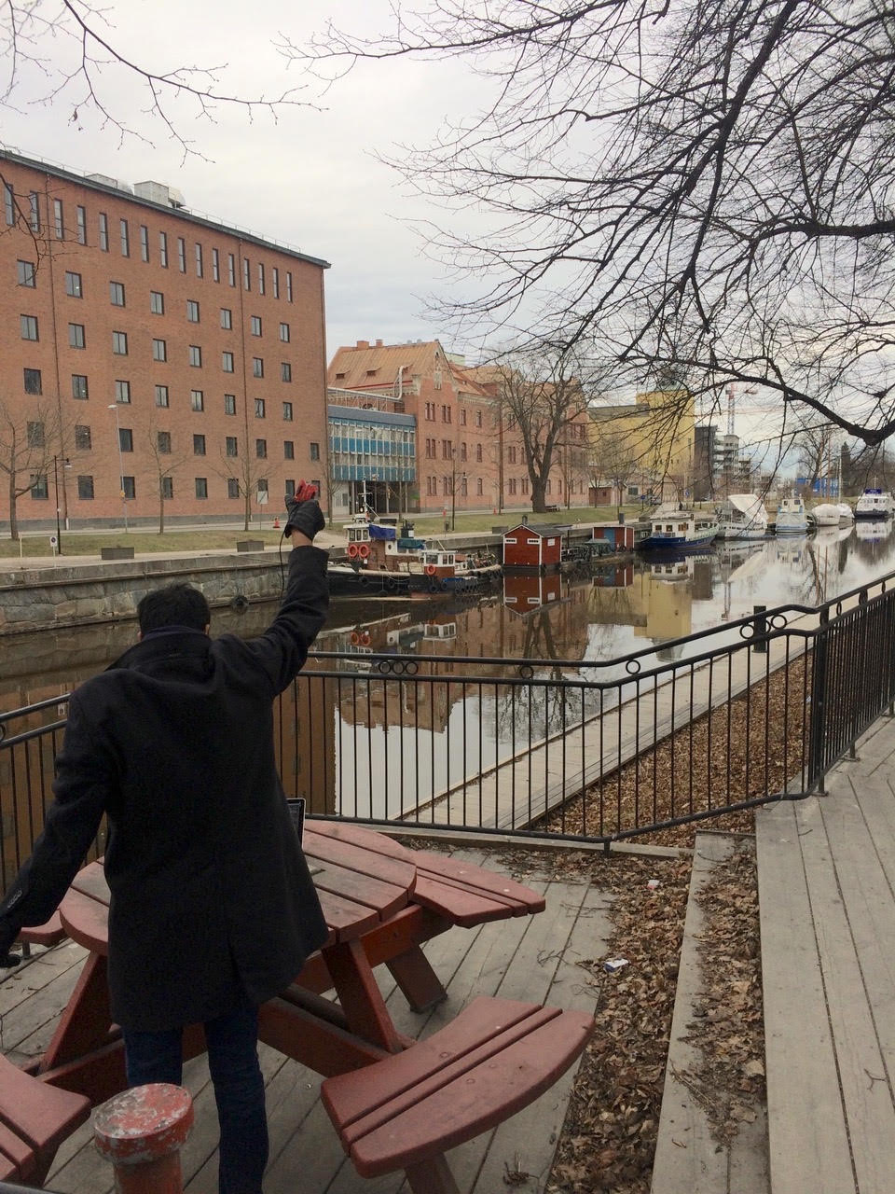
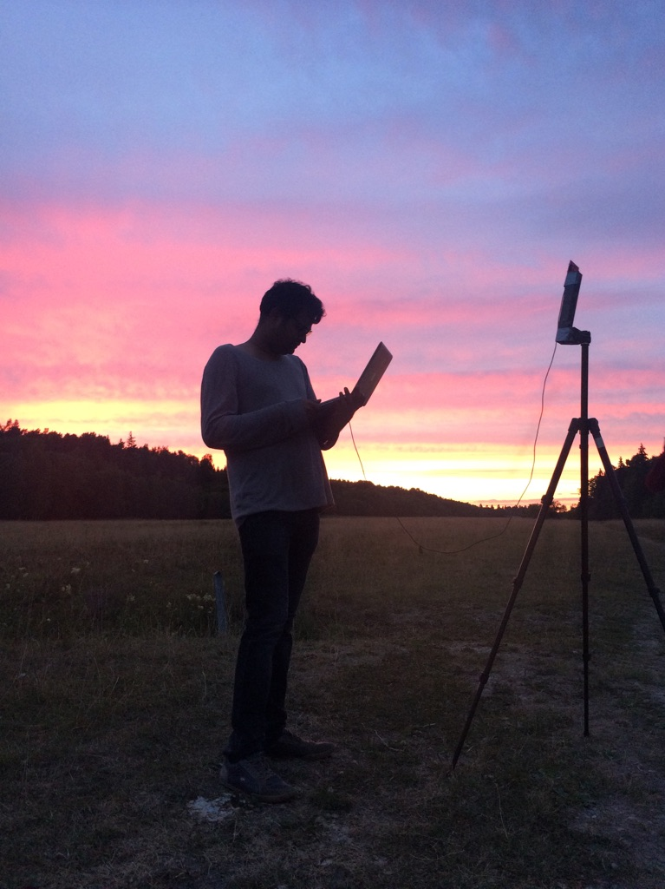
Long range depends on receiver sensitivity and transmit power
Receiver sensitivity improves with lower bitrate/bandwidth
Low bitrate, narrow band signals, very high receive sensitivity
Large transmit power, high receive sensitivity -> Very large range
LoRea: -124 dBm at < 1 kbps, 2 FSK

Slide 71
Design a low-power wide-area network
Any particular MAC choices for lower power?
Diversity of devices in network
High power gateway, low power devices in star topology
Devices should be off whenever possible
Listen-after send for downlink
Remove requirements for synchronization
No TDMA access control if it can be avoided
Aloha, CSMA

Slide 72
Long-range CSMA is problematic
Long-range makes everything more challenging
Kilometers of range mean kilometers between devices
Detection of channel use is less reliable
Active research in clear channel assessment for LPWANs
Hidden terminal problem has a wider range
Might make RTS/CTS more important
Result: CSMA doesn’t dominate LPWANs like it does WLANs

Slide 73
LPWANs overview (common qualities)
Unlicensed 915 MHz band (902-928 MHz)
Higher power transmissions: ~20 dBm (100 mW)
Low data rate 100 kbps or less
Range on the order of multiple kilometers
Simple Aloha access control

Slide 74
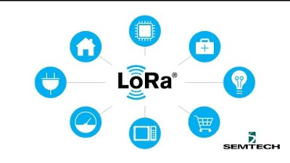
Overview of LoRa standard (Courtesy: Semtech)

Slide 75
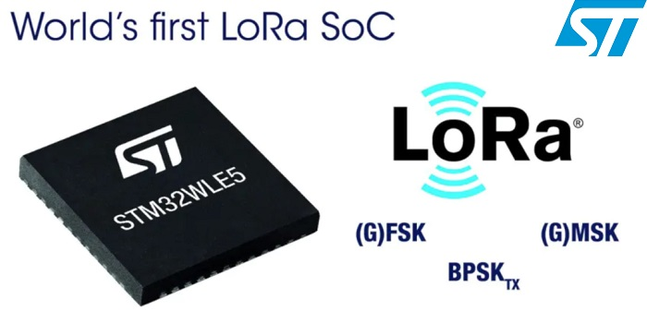
LoRaWAN
Open communication standard built with proprietary LoRa PHY
Operates in the unlicensed band
Low data rate (1-20 kbps) and long range (~5 km)
Most popular LPWAN protocol
Academic research and industry involvement

Slide 76
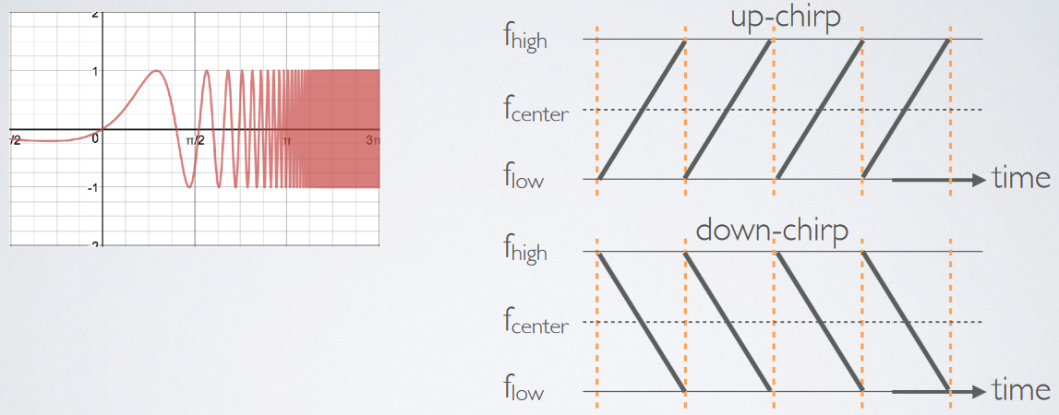
LoRa employs a different modulation scheme
Chirp Spread Spectrum (CSS): Modulation technique where frequency is varied linearly from lowest to highest within a channel

Slide 77
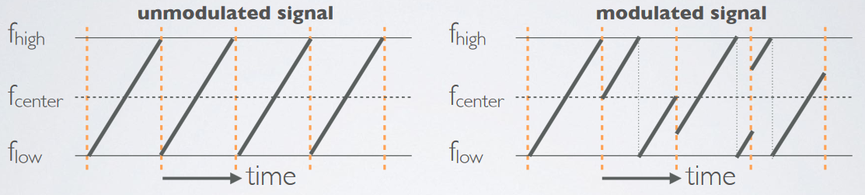
Chirp Spread Spectrum
Data is modulated in the starting and ending points of chirp
Frequency increases linearly, modulo bounds of the channel

Slide 78
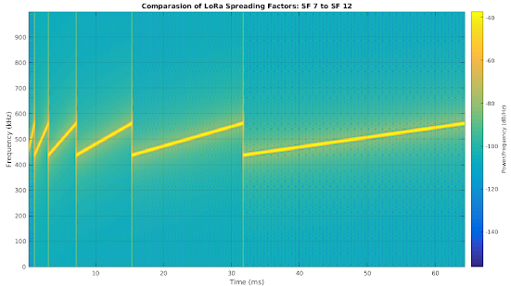
Spreading factor of CSS modulation
Spreading Factor is essentially the rate-of-change of frequency
Slope of the line
Lower values of spreading factor (steeper slope) are faster data rate
Important: different spreading factors are (mostly) orthogonal!
Two can overlap in time, space, and channel without a collision

Slide 79
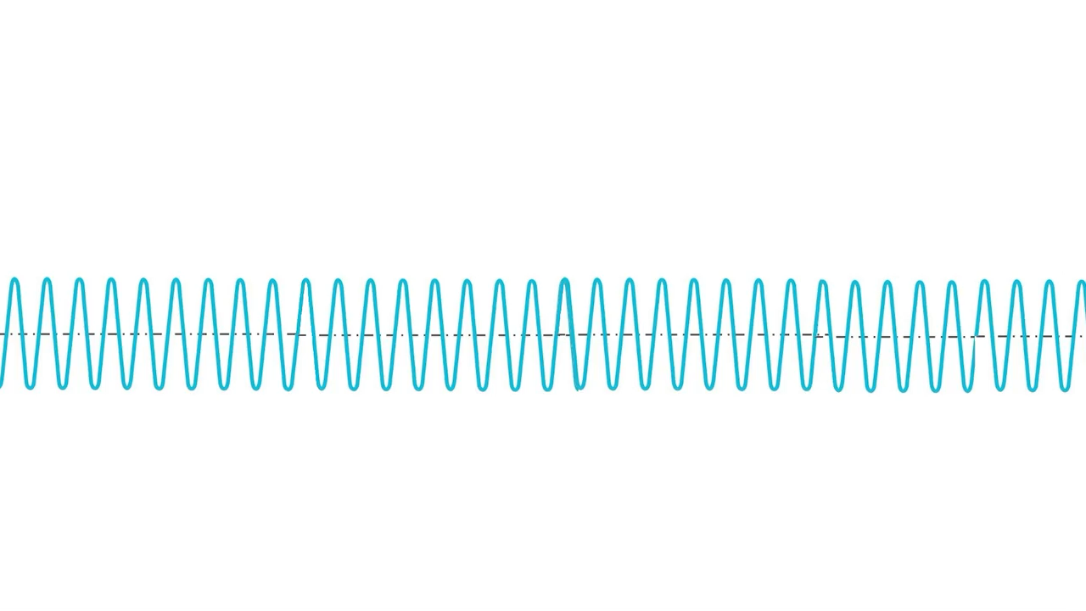
Overview of CSS (brief video)

Slide 80
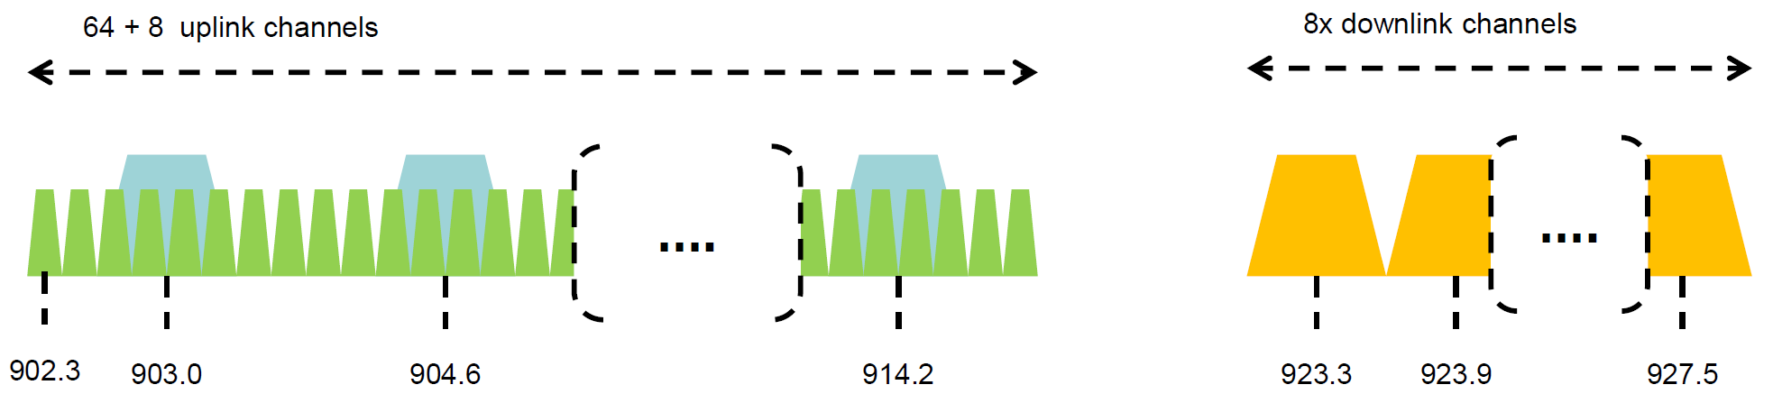
Channel allocation for LoRa
Sixty-four, 125 kHz uplink channels
Frequency Hopping over the 64 uplink channels
Plus eight, 500 kHz overlapping uplink channels (not well used in practice)
Eight, 500 kHz downlink channels

Slide 81
LoRa data rates
Data Rate Index | Spreading Factor | Bit Rate
125 kHz Uplink Rates
0 | SF10, 125 kHz | 980 bps
1 | SF9, 125 kHz | 1760 bps
2 | SF8, 125 kHz | 3125 bps
3 | SF7, 125 kHz | 5470 bps
500 kHz Uplink Rates
4 | SF8, 500 kHz | 12500 bps
500 kHz Downlink Rates
8 | SF12, 500 kHz | 980 bps
9 | SF11, 500 kHz | 1760 bps
10 | SF10, 500 kHz | 3900 bps
11 | SF9, 500 kHz | 7000 bps
12 | SF8, 500 kHz | 12500 bps
13 | SF7, 500 kHz | 21900 bps
Data rate depend on channel in use, spreading factor
64-channel uplink
1-5 kbps data rate

Slide 82
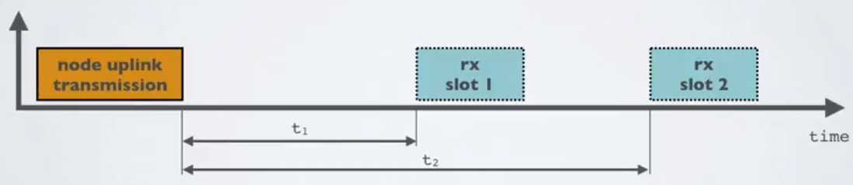
LoRaWAN MAC
Uplink: Aloha - transmit whenever
Randomly split across 64 uplink channels (reduced odds of collision)
Devices a different spreading factors also do not collide
Packets are very long though: up to 400 ms in duration
Downlink: listen-after-send (class A device)
Two windows for RX on different channels

Slide 83
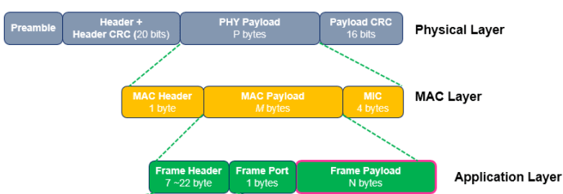
LoRaWAN packet format
Frame header includes device address
MAC Payload maximum size depends on data rate
Again based on dwell time in the US
Data Rate Index | MAC Payload Size
0 | 19 bytes
1 | 61 bytes
2 | 133 bytes
3 | 250 bytes
4 | 250 bytes

Slide 84
LoRa link budget and transmission range
Typical TX power 20 dBm
Up to 30 dBm for 64-channel hopping
Up to 26 dBm for 8-channel hopping
Receive sensitivity -119 dBm/-146 dBm (highest SF)
Compare to -100 dBm for 802.15.4 and -95 dBm for BLE
Resulting range is kilometers in urban environments

Slide 85
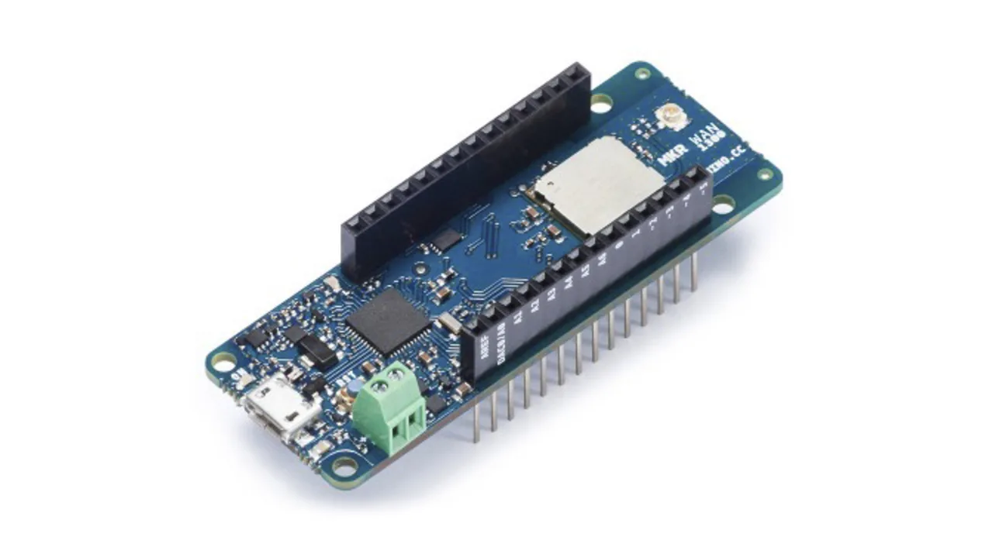
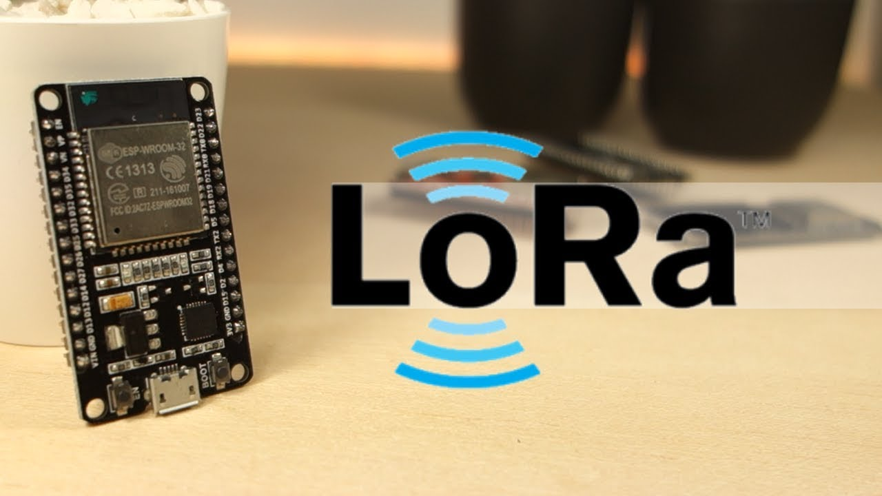
You can build your own LoRa network
Easy-to-use, off-the-shelf hardware available (tens of USD)
Could be useful for projects that you may do in this course

Slide 86


LoRaWAN network providers
Network provides with a deployment of gateways
The Things Network (predominantly in Europe)
Helium
Any can buy and install their own gateway, which serves everyone
Microtransactions to pay for communication

Slide 87
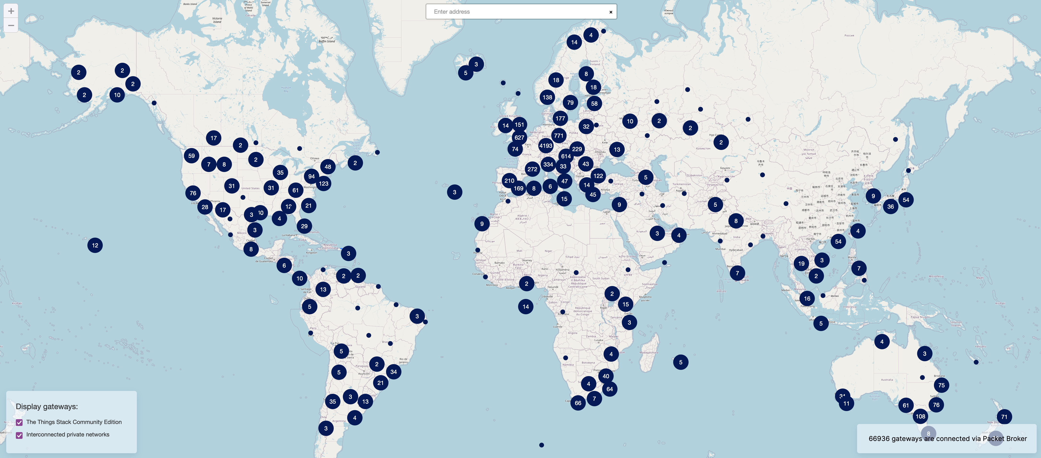
TTN Scale [Jan 2022]

Slide 88
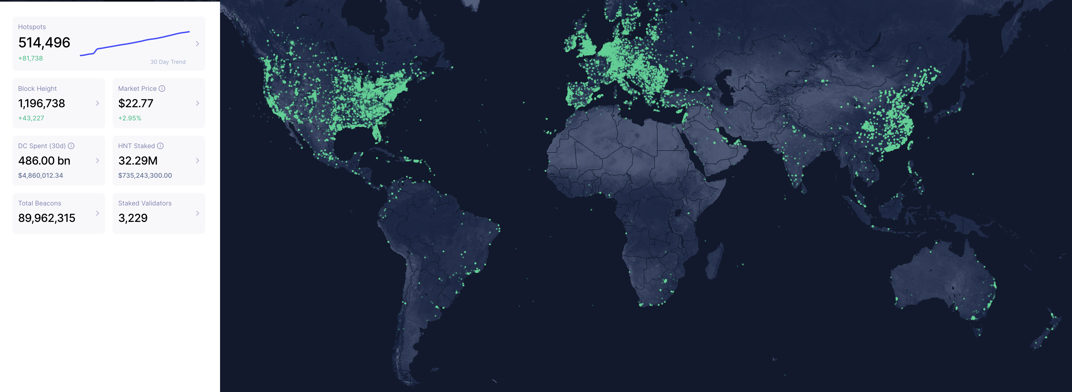
Helium Scale [Jan 2022]

Slide 89

Sigfox
Very low-rate (600 bps), very long-range (10+ km) communication
Star-topology networks, with always-listening gateways
Any number of low-power end devices
Uplink-focused communication
Applications: very low-rate metering

Slide 90
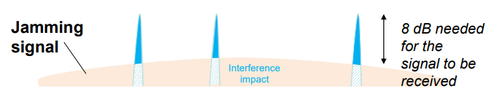
Sigfox PHY
Unlicensed-band communication
Europe 868 MHz. US 902-928 MHz (915 MHz band)
Ultra-narrowband 600 Hz (100 Hz Europe) channel bandwidth
Detection only needs to occur at very specific frequency
Helps improve signal-to-noise ratio

Slide 91
Sigfox unbalanced uplink and downlink
Uplink
600 Hz bandwidth, 600 bps, DBPSK
Downlink
1.5 kHz bandwidth, 600 bps, GFSK
Particularly optimized for Europe
Uplink on 1% duty cycle channel, up to 14 dBm
Downlink on 10% duty cycle channel, up to 27 dBm
Works fine in US too
Gets more power (24 dBm up is typical, up to 32 dBm down) and more range

Slide 92
Sigfox link budget
Why transmit at 100-600 bps?
For greatly increased link budget
Link budget: 150-160 dBm
Assuming Tx at ~20 dBm
Means Rx Sensitivity of -130 dBm (10 dBm better than LoRaWAN)
Resulting range: 10-15 km in urban environments
Except that buildings lead to dead spots in range

Slide 93
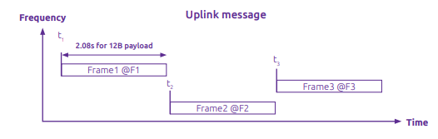
Sigfox MAC
Aloha-style access control (send whenever)
No acknowledgements!
Send message three times for increased reliability
Then listen for downlink at a set period later on a known frequency

Slide 94
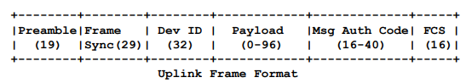
Sigfox uplink packet
Up to 29 bytes total per packet
Payload: up to 12 bytes
Other fields
Preamble + Frame Sync are really a 6 byte field for radio sync
Authentication: 2-5 bytes
Frame Check Sequence: 16-bit CRC

Slide 95

Sigfox downlink packet
Similar structure, 28 bytes total
Payload: up to 8 bytes
Larger preamble + frame sync of 13 bytes
Error Correcting Code for increased reliability

Slide 96
Sigfox deployments
Proprietary network with managed deployment
Like cellular networks
Sigfox deploys networks and transports data
140 uplink messages plus 4 downlink message per day
Connectionless communication
Devices are registered with the networks
Keys are provided in the software image
Any deployed Sigfox gateway can collect transmitted data
Enables mobile applications

Slide 97
IEEE standard for LPWANs
n.b.
802 = “area networking”
.3 = “LANs”
.11 = “Wireless LANs”
.15 = “PANs”
802.11ah (HaLow) standard in 2016
First real hardware in 2020
Still not in real-world use yet
Focus on the indoor-to-outdoor scenario
Medium range (maximum 1 km)
915 MHz communication
NOT interoperable with other 802.11 access points and devices
Theoretically up to 356 Mbps
Practically, most devices are expected to implement 150 kbps to 8 Mbps

Slide 98

802.11ah allows multiple bandwidth allocations

Slide 99

WiFi Hallow Range Test (Courtesy: Newracom)

Slide 100
Roadmap of the lecture today
General course information and updates
Let us review what we had covered the last lecture
Localization continued
Node discovery
Wide Area Networks
Routing
Notes:
Here is the roadmap of the major topics that I am going to cover during the presentation. We have already covered the exponential growth of the internet of things; next, I will talk about the critical energy challenge that can severely hinder this massive growth and preventing us from realising this immense economic value enabled by the IoT.

Slide 101
Routing

Slide 102
What do you mean by routing?
Have a packet, have a destination, how do we network them?
Routing is trivial if all nodes are connected to each other
Problem: if N nodes, need N(N-1) or O(N²) (uni-directional) links
Trivial for wireless, but number of links may grow.
Simple techniques: broadcast, tree structures
Mesh techniques: understand available routes and select a “good” one

Slide 103
Performing routing in the wired networks
Number of links can be reduced significantly with one “BIG” switch with N links and routing is still simple
Problem: If N is large and nodes can be far apart (think of the Internet)
Adding more switches/routers reduces the size of the switches/routers needed and allow network to grow
But Routing will be more complex!

Slide 104
Performing routing in the wireless networks
Routing protocols are complex, hard to maintain/debug and incurred significant overhead. More so for wireless networks.
In practice, wireless network deployments are single-hop and routing is trivial. All stations/devices communicating directly with base stations
Example: WiFi, Cellular Network, LoRa
Can one-hop communication be always sufficient by using sufficiently long range radio and large number of base stations?
Why multi-hop routing?
is strictly better in terms of reach/coverage for the same number of base stations
provides more routes, potentially more robust

Slide 105
For the same distance, is it better to have direct or multi-hop path?
A
B
A
C
D
E
B
Which option is better?
Typically, a single-hop is considered better

Slide 106
But, for energy Consumption …
Is multiple-hop transmission more energy efficient than a single-hop ?
Let us Recall the free space model: Pr = C P_{t} / dª (C = constant)
Transmission over a distance d, let minimum received power needed be P₀
1 transmission to cover distance d, transmission power (P₁) needed is
P₀ = C P₁ / dª or P₁ = P₀/C * dª
N transmissions to cover distance d, transmission power needed (P_{N}) per hop is
P₀ = C P_{N} / (d/N)ª , or P_{N} = P₀ /C * (d/N)ª
Total transmission power is N P_{N} = N P₀ /C * (d/N)ª
Which approach (1 transmission vs N transmissions) is more energy efficient?

Slide 107
Classification of c routing protocols
The existing routing protocols can be classified as:
Proactive: when a packet needs to be forwarded, the route is already known
Reactive: Determine a route only when there is data to send

Slide 108

Many-to-one routing
Tree optimization for sensor networks
Keep all devices except the “gateway” as simple as possible
Each device only needs to remember hop to gateway
If gateway wants to send message back, it must include a full hop path

Slide 109
Mesh Routing
Formed by a network of static wireless nodes
Mesh topology makes routing question more complicated
Multiple hops in a route
Multiple routes between source and destination
Becomes a graph theory question based on cost metric
B
C
A
D
F
E

Slide 110
Flooding
Mesh equivalent of broadcast
Each node sends to each other node
Eventually packets will reach the desired destination
Not really routing at all…
Question: how do we make it stop?

Slide 111
Flooding
Mesh equivalent of broadcast
Each node sends to each other node
Eventually packets will reach the desired destination
Not really routing at all…
Question: how do we make it stop?
Maximum retransmissions counter on each packet
Decrement at each hop. Drop packet when it hits zero
Need some guess for how many hops to destination
Keep some history of recently flooded packets
Don’t retransmit a recently sent packet

Slide 112
Roadmap of the lecture today
General course information and updates
Let us review what we had covered the last lecture
Localization continued
Node discovery
Wide Area Networks
Routing
Notes:
Here is the roadmap of the major topics that I am going to cover during the presentation. We have already covered the exponential growth of the internet of things; next, I will talk about the critical energy challenge that can severely hinder this massive growth and preventing us from realising this immense economic value enabled by the IoT.

Slide 113
Wireless Networking
Ambuj Varshney
ambujv@nus.edu.sg
Notes:
++ Thank you for inviting me to give this talk
++ In this talk, I will present a pathway that can enable us to make wireless embedded systems ubiquitous. I will describe my previous research efforts that tackle the critical challenges that limit the growth of wireless embedded systems. These are related to the growing energy asymmetry that exists between sensing, computation and communication blocks on these platforms.
++ Finally, I will conclude my talk by covering the research agenda that I would like to work on as a faculty member.

